Slide 1
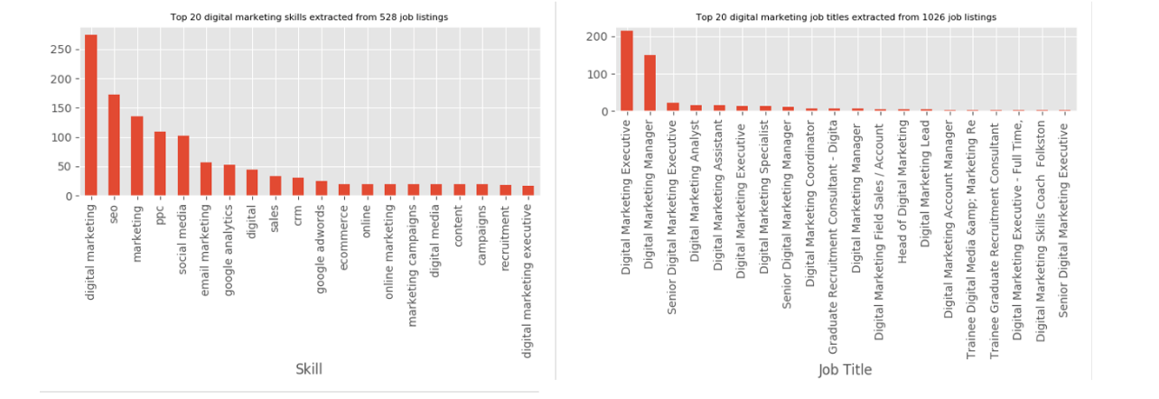
Graduate Skills Scrapping Tool
Research Project
Aim: To create a ”script” or “program” that can “scrape” 1000s of related job ads from any industry.
The purpose of which is to help inform course design of University's (specifically RGU) to enable courses and assessments to reflect the actual needs of industry and as such enhance graduates’ employability.
Possible tools: Python + appropriate libraries (to be scoped by student)
Supervisor(s): Jack Keenan, Elliot Pirie, Mark Zarb

Slide 2
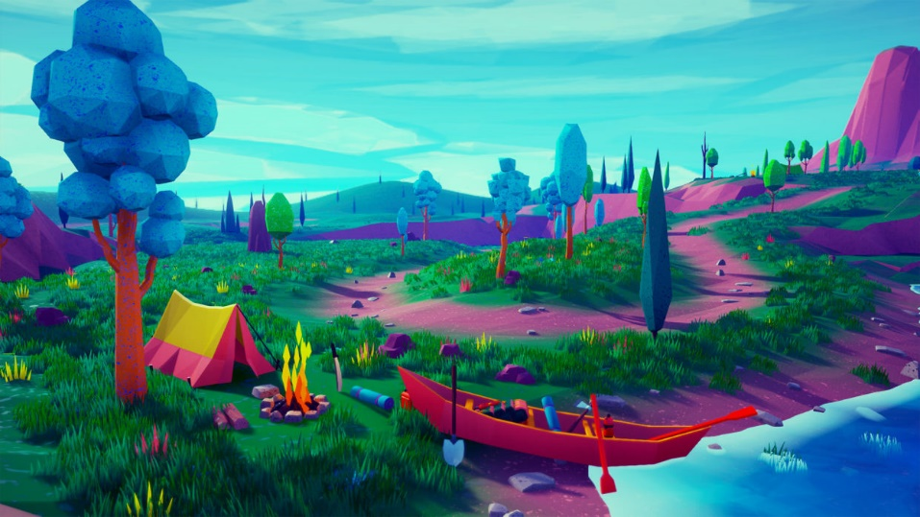




Your VR Environment
Research Project
Aim: To develop a customizable 3D environment, compatible with Virtual Reality and that uses an ‘itinerary system’ to allow the addition/removal of assets that add personality to your custom-made space.
Possible tools: This project will make use of a Meta Quest headset (2 or 3) and require a game engine such as Unity. There will be scripting involved both on a visual level but also, with hard code via C#. The Asset Store (or similar) will be used in the project and should be on a royalty free basis, but use of Blender for ‘custom’ assets may be a possibility. There will be the need for some specialist interaction tools when looking at itinerary use.
Image: Emek Can Özben
Supervisor: Jay Munro

Slide 3
Mining and Analysis of Supermarket Data to Understand Price, Sustainability and Dietary Trends
Research Project
Project description: This project aims to develop a dashboard that health professionals can use to obtain updated data (price, ingredients, carbon footprint, packaging, cooking times, amongst others) from a series of supermarket products. Users should be able to obtain periodically the most updated data and store it to perform historical comparisons. Moreover, they should be capable of filtering certain categories in and out to refine their visualisations. The system should also make use of Machine Learning models that can perform feature prediction (for instance, will the price or the demand of a certain product go up/down) considering the fundamentals of Time Series Analysis. Some of the data to be analysed will be unstructured (such as the list of ingredients, which comes as plain text); thus, there is a need to implement Natural Language Processing techniques to clean these inputs.
Skills demanded: Interest in Data Analytics and Visualisation, understanding of Time Series Analysis, Machine Learning and Natural Language Processing. Notions of R and Python are preferred, plus knowledge of dashboard development tools, such as Tableau, Power BI, Heroku, Dash Plotly or similar.
Students to accommodate: 1-2
Supervisor: Carlos Moreno Garcia

Slide 4
We" vs. "Them" Language Analysis on Social Media
Research Project
We" vs. "Them" Language Analysis
Objective: Analyze social media posts to understand how "we" and "them" language is used to construct group identities and define enemies.
Tools: NLP and text analysis software.
Process: -
Data Collection: Gather a large dataset of social media posts from various platforms. –
Analysis: Identify and categorize posts using "we" and "them" language. Examine the context and sentiment of these posts.
Outcome: Insights into how different groups use language to establish "otherness" and promote distrust.
Supervisor: Shahana Bano

Slide 5




SoSAct: Leveraging Software Security and AI to Safeguard People from Cyber Terrorism
Research Project
The rapid growth of digital technologies has significantly transformed modern-day terrorism. Terrorist organisations now exploit the internet and software vulnerabilities to coordinate attacks, recruit members, spread propaganda, and evade detection by law enforcement.
Counterterrorism strategies have evolved to include digital and cyber defense mechanisms. However, as software ecosystems grow in complexity, they become increasingly vulnerable to exploitation by malicious actors.
This project named as SoSAct will explore the current challenges in software security that threaten the counterterrorism efforts and propose innovative solutions to mitigate these risks. SoSAct is also going to address these challenges using AI driven techniques to enhance the security of the software.
Identify Evaluate Propose Promote
Identify Key Threats:
Analyze current software vulnerabilities that terrorists and cybercriminals exploit to target the infrastructure and communication systems.
Evaluate Existing Solutions:
Assess the effectiveness of existing counterterrorism strategies, with a focus on software security measures.
Propose Security Enhancements:
Develop a framework of best practices and innovative solutions with AI-driven detection to improve the security of software systems in critical sectors which are leading to cyber terrorism.
Promote Policy and Collaboration:
Provide recommendations based on the model usage for improving collaboration between the government, private sector, and international partners to strengthen cybersecurity and counterterrorism measures.
Supervisor: Janaka Senanayake

